Slide 1



Spring 2024 Analyzing Pandemic Responses Project
Understanding the Nexus: Government Policies, Economic Support, and COVID-19 Mortality Rates in Four Nations
RESEARCH
By
Aarushi Tuli – Boston University
Kaushik Patil – Boston University

Slide 2

Why this is important?
The ongoing COVID-19 pandemic, instigated by the SARS-CoV-2 virus, presents a multifaceted clinical spectrum.
This research paper focuses on the impact of COVID-19 pandemic on different policies in four countries of the world.

Slide 3
Let’s get a whole picture
How many deaths occurred per country in the years 2020, 2021, and 2022?
Which are the top four countries?

Slide 4
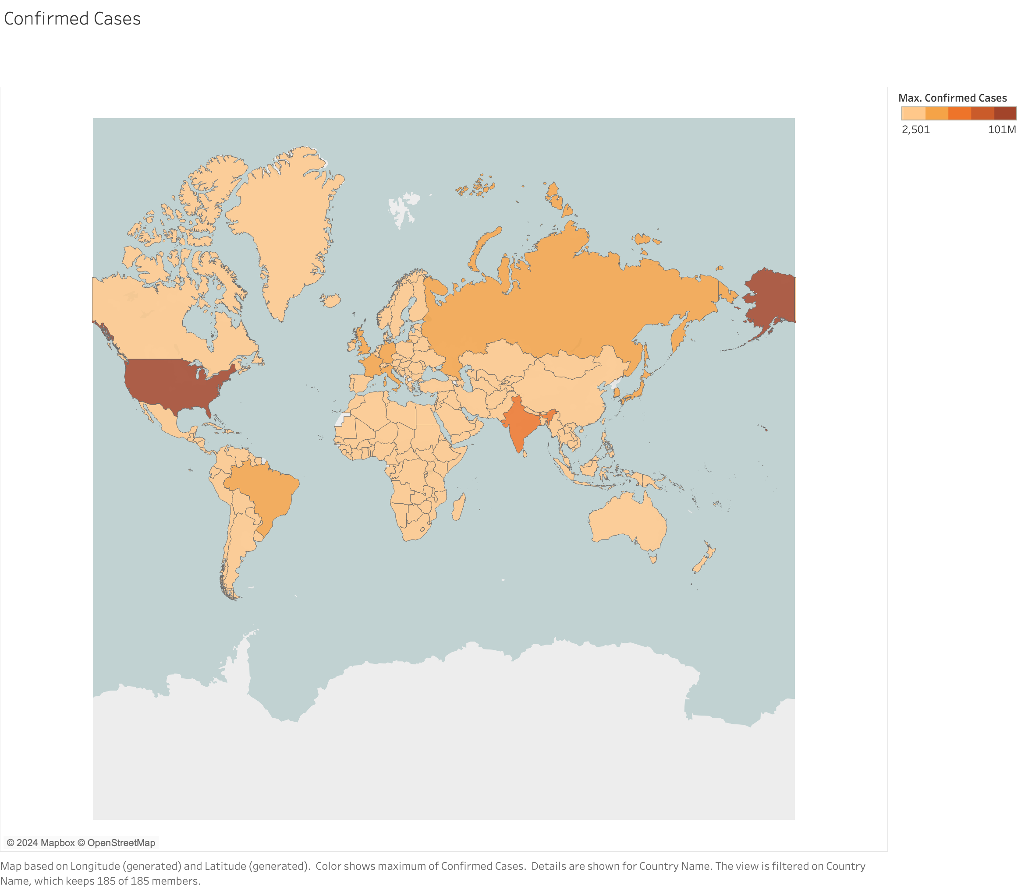

Slide 5
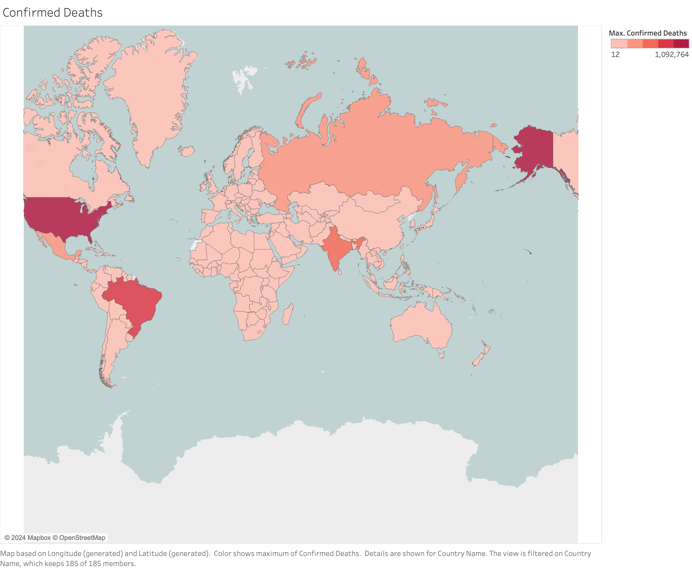

Slide 6
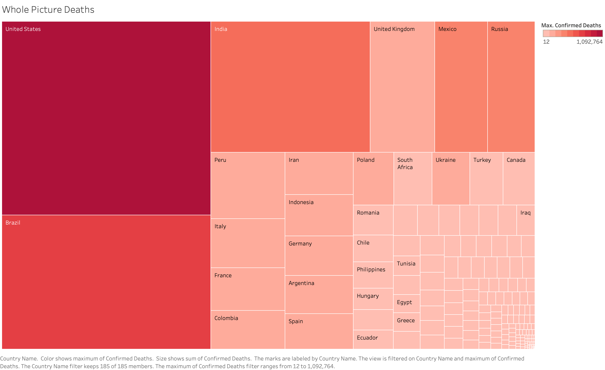

Slide 7
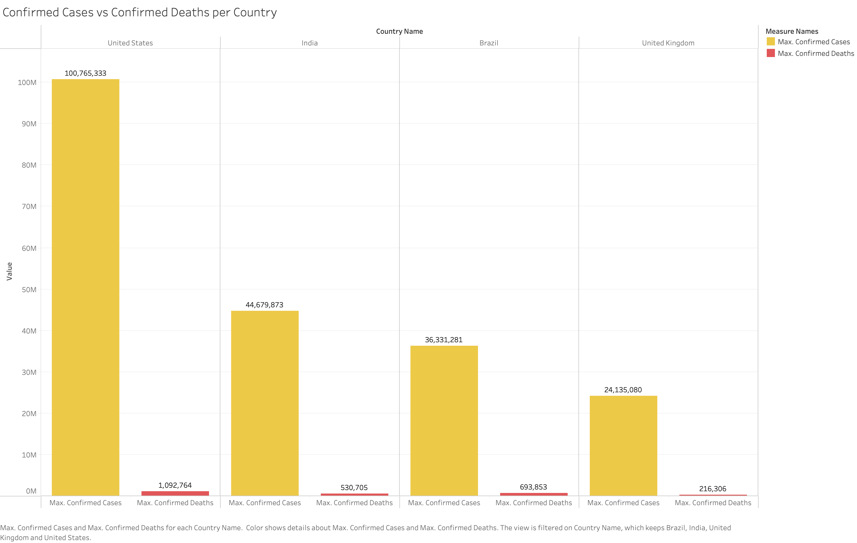

Slide 8
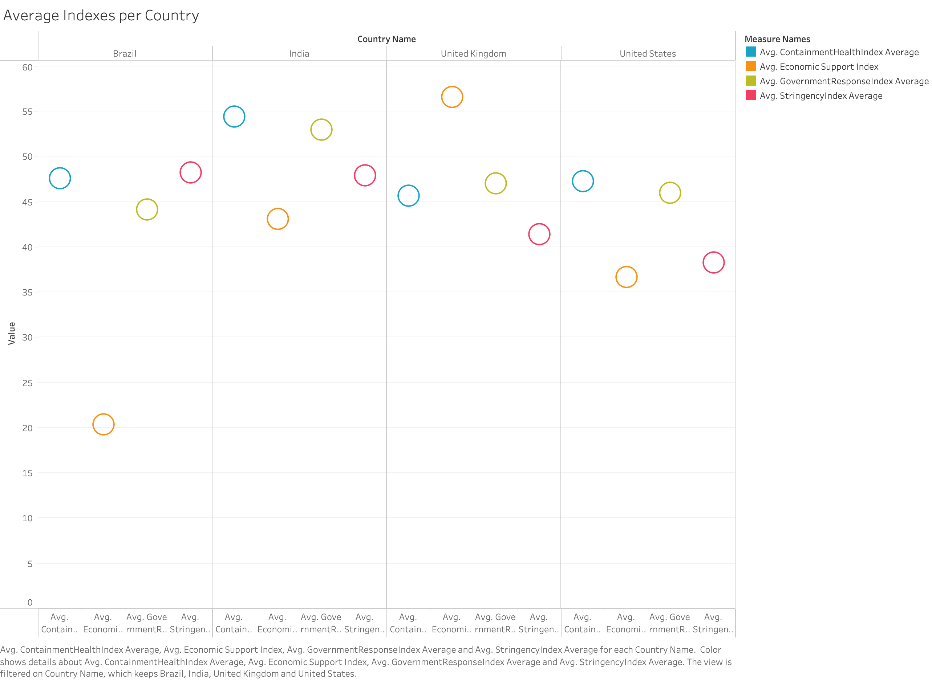

Slide 9
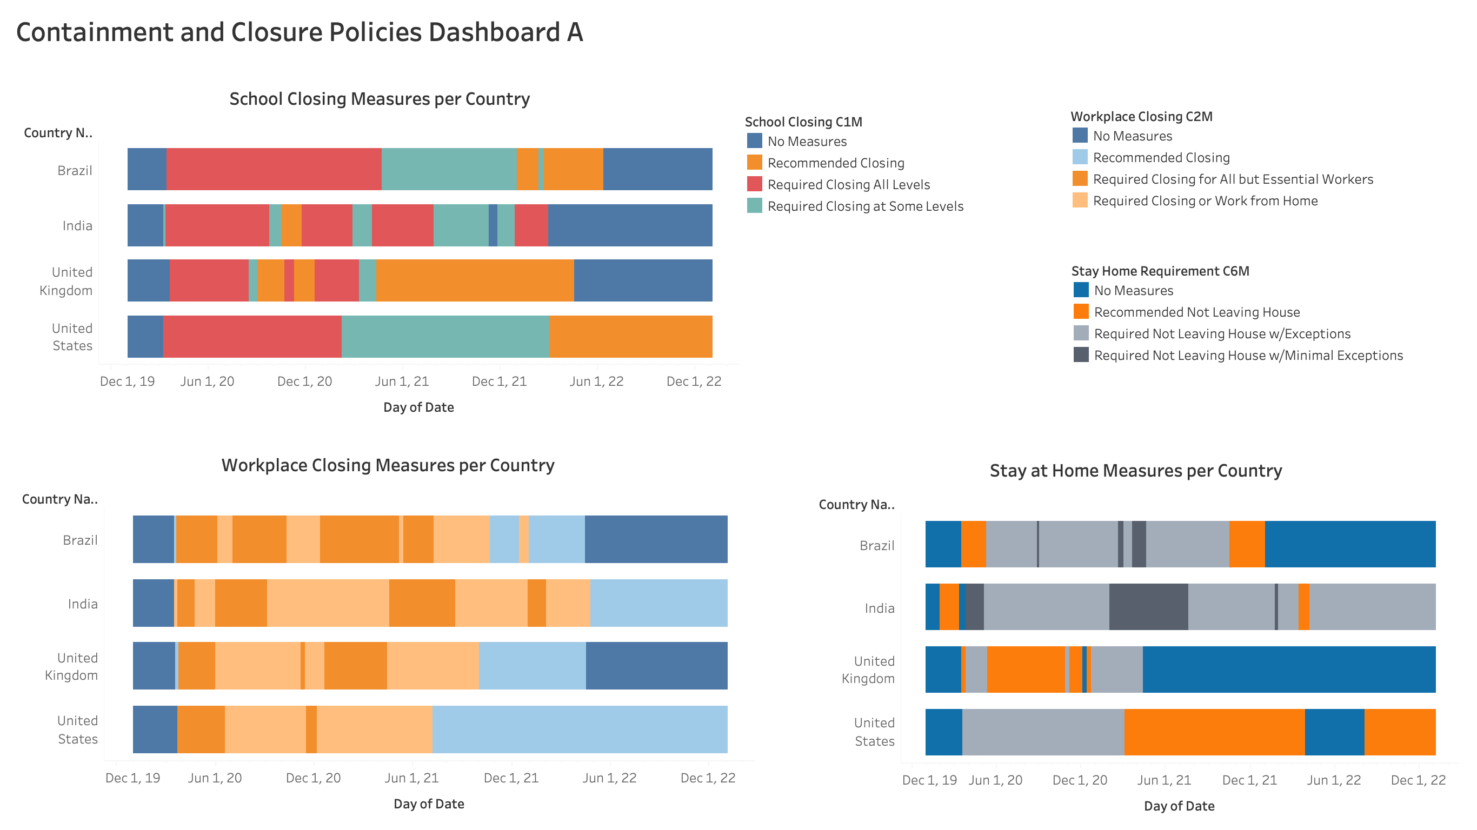

Slide 10
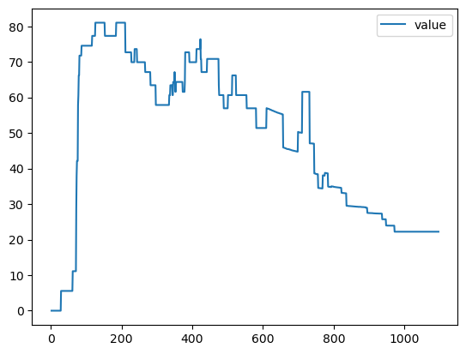
Time series Model on Stringency Index on U.S.A, U.K., Brazil, India

Slide 11
Developed ML model for Economic Index
Achieved 99% accuracy with linear regression
Tested 11 models, selected linear regression
Experimented with hyperparameters

Slide 12
Developed ML model for Stringency Index
Used decision tree model
Achieved 99% accuracy

Slide 13
Now let's create new data for prediction
Variable | Value
C1M_School closing | 1 - recommend closing or all schools open with alterations resulting in significant differences compared to non-Covid-19 operations
C2M_Workplace closing | 2 - require closing (or work from home) for some sectors or categories of workers
C3M_Cancel public events | 2 - require cancelling
C4M_Restrictions on gatherings | 4 - restrictions on gatherings of 10 people or less
C5M_Close public transport | 0 - no measures
C6M_Stay at home requirements | 0 - no measures
C7M_Restrictions on internal movement | 2 - internal movement restrictions in place
C8EV_International travel controls | 1 - screening arrivals
H3_Contact tracing | 0 - no contact tracing

Slide 14

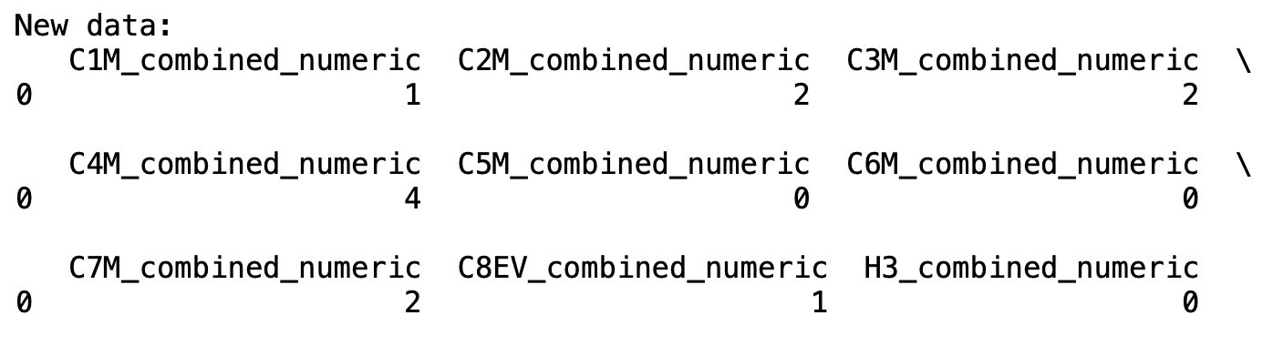
Guess what's the predicted value?
This indicates that the stringency index, based on the input parameters, is expected to be 59.26.
We utilized a decision tree model for this prediction.

Slide 15
Conclusion
The implications of the correlation between government policy indexes and COVID-19 mortality rates suggest that the stringency of measures and the extent of economic support provided by authorities play crucial roles in mitigating the impact of the pandemic.
Despite India's robust policy responses, including stringent containment measures and proactive government actions, its mortality rate remains notably high. Conversely, the United Kingdom's emphasis on economic support initiatives, coupled with relatively lower stringency measures, seemingly contributes to its lower mortality rate compared to the US.
This suggests that while stringent containment measures may curb virus transmission, robust economic support measures can also play a pivotal role in reducing mortality by mitigating the socio-economic impact of the pandemic.

Slide 16
The highest number of deaths observed in the US, followed by India, Brazil, and UK, may be partially attributed to the varying strategies..
For instance, the US experienced a significant number of deaths despite recommending workplace closing and stay-at-home measures, possibly indicating challenges in adherence or effectiveness of these policies.
In contrast, India's transition to 'required not leaving home' policies coincided with a surge in deaths, suggesting a potential lag in containment efforts or other contributing factors.
Brazil's absence of stay-at-home policies in 2022, coupled with fluctuations in school and workplace closures, may have contributed to the high mortality rate observed in the country.

Slide 17

Further Research
Before implementing such a recommendation, further research is needed to assess the specific socio-economic contexts of different regions and evaluate the feasibility and impact of integrated public health and economic strategies.

Slide 18

Policy Recommendation
Develop and implement comprehensive policy frameworks that prioritize both public health measures, such as containment strategies and vaccination campaigns, and economic support initiatives, including financial assistance to individuals and businesses affected by the pandemic.

Slide 19

Thank you everyone and special thanks to our mentor Julie Meunier.

